Slide 1

Future-Proofing Your Content and Workflows
Eric Freese
O’Reilly Tools of Change
02.23.10
aptaracorp.com

Slide 2


Agenda
Introducing Aptara
Today’s Environment
Getting From Here to There
Digital First & XML
2
Confidential. Not for distribution.

Slide 3















Aptara – Overview
Inception | 1988
Locations | 9 global locations Delivery centers – India, USA Sales and Business Development – USA, UK and Australia
Segment | Content Transformation Solutions - Developing, composing and transforming static information into consistent, dynamic digital content that can be repurposed for future use
Employees | 3,700+
Key Customers
Recognized Brand | Largest player in content transformation space Ranked 18th in Dataquest Top 20 BPO companies in India in 2007
Proven Track Record | Revenue CAGR of 22% over 3-year period
Notes:
3

Slide 4
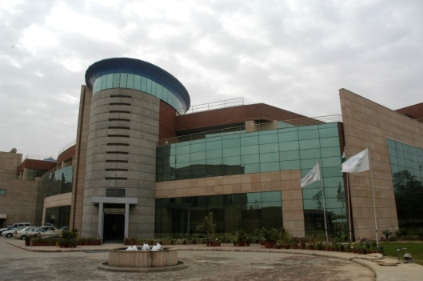
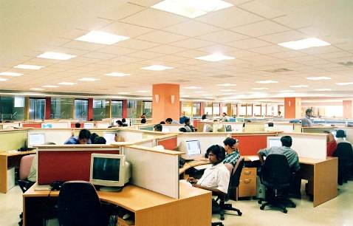
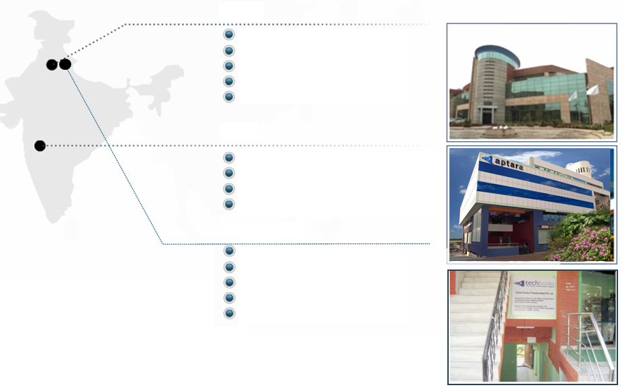
Global Locations
`
`
U.S. Locations
Falls Church, VA
York, PA
Boston, MA
Europe Locations
Cambridge, U.K.
Australia Location
Sydney
India Locations
New Delhi
Dehradun
Pune
Trivandrum

Slide 5
Agenda
Introducing Aptara
Today’s Environment
Getting From Here to There
Digital First & XML
5
Confidential. Not for distribution.

Slide 6
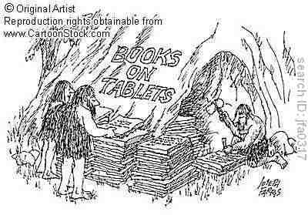
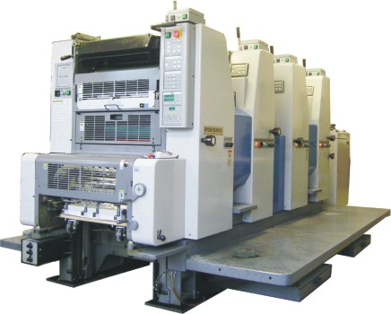
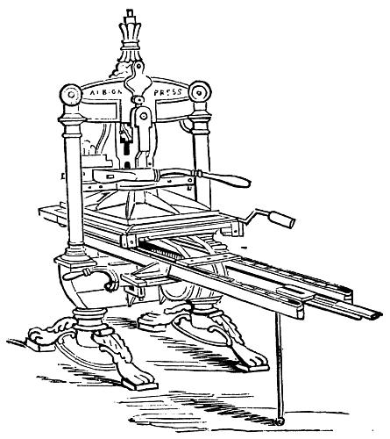

In the beginning, there was print …
… and it was good
6
Notes:
Faced with disruptive technology challenges from new electronic delivery channels, publishers are racing to keep pace. But while eBooks are on the rise, the lion’s share of revenue is still from print. So how far down the transition path from print to digital should publishers really be?

Slide 7
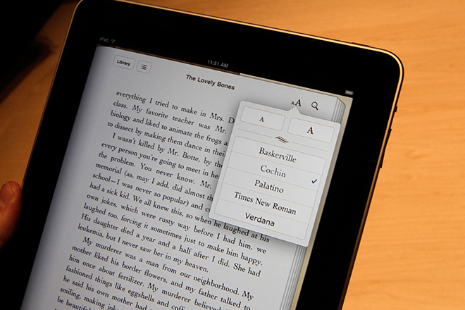
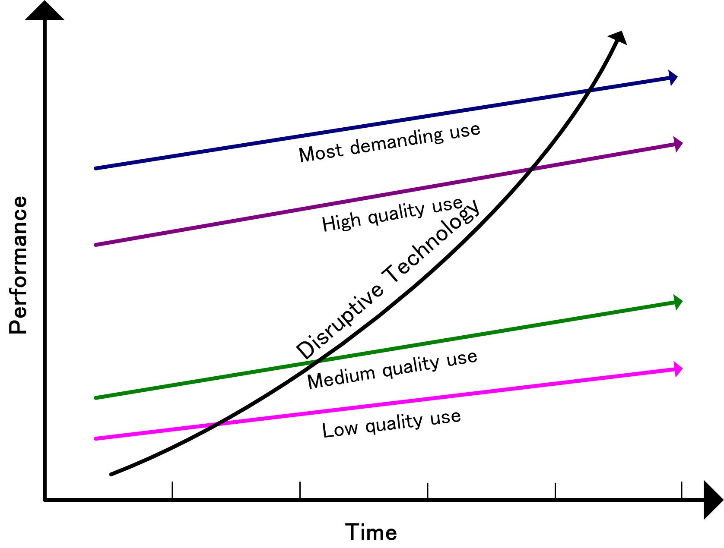
Now there are eBooks
  Disruptive
  Require new workflows
  Questionable ROI
  Threat or opportunity?
  Challenging
7
Notes:
So how far down the transition path from print to digital should publishers really be?
Better yet, what if it wasn’t a question of either/or?

Slide 8
What today’s consumer wants…
… everything
  Twitter
  YouTube
  MySpace
  Apps
  Facebook
  Music
  LinkedIn
  eBooks
  Streaming audio/video
  GPS/Geolocation/Augmented Reality
  Real-time news
… and they want it NOW!

Slide 9
What today’s publisher wants…
Meet consumer’s ever-changing expectations
Deliver the right info at the right time in the right format
Move from print to dynamic, online products
Create new revenue streams & channels
Cut cycle times & production costs
Be nimble in the face of an uncertain market
Notes:
The recession have taken a tighter and tighter death-grip on the print industry. Publishers are making a bigger leap into the digital arena in an effort to stay competitive
Lets look at the key expectations the various players with the content life cycle have….
Today’s information buyers demand access to content WHEN they want it, HOW they want it, and DELIVERED according to individual preference. They want to choose from any channel, any format, anywhere, anytime. If they are interested, you must capture the interest immediately, or they will find an alternate source.
All publishers – all enterprises face multiple goals. Being successful is a balancing act, making sure that you have the right resources allocated to the right projects. It’s not enough to stand still. You must plan for the future at the same time you seek productivity gains and cost savings.
As none but the largest organizations can afford to do everything in house, it’s key to find the right partners with the right knowledge to compliment your strengths and achieve your objectives.

Slide 10
What today’s publisher has…
Large volumes of content ready to be delivered
  Mostly printed
  Stored in expensive warehouse space
  Older publications may no longer be available
  Original material trapped in proprietary publishing/layout systems

Slide 11
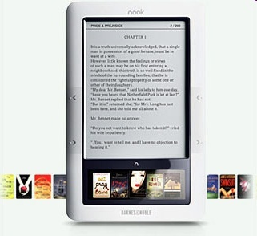
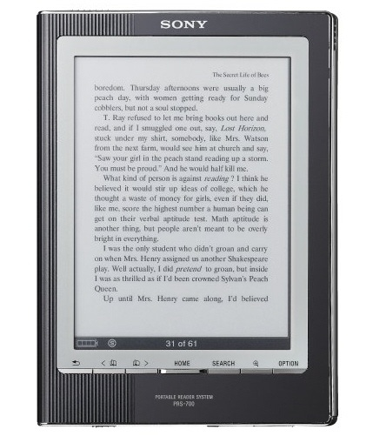
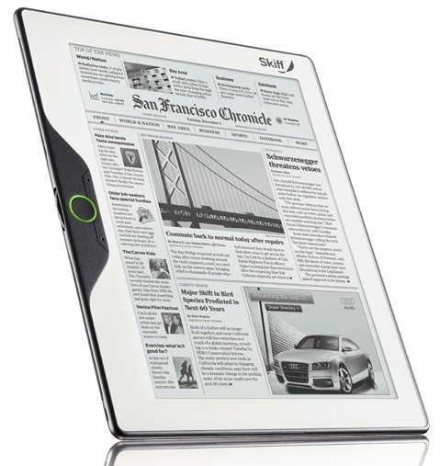
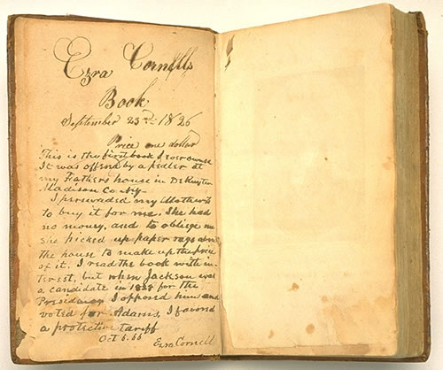

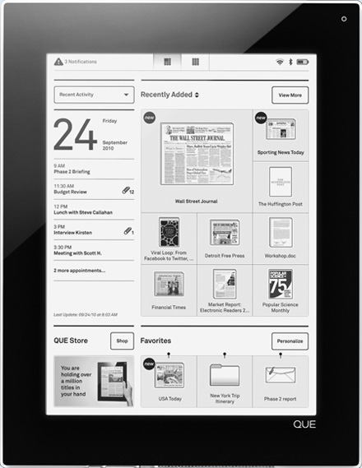

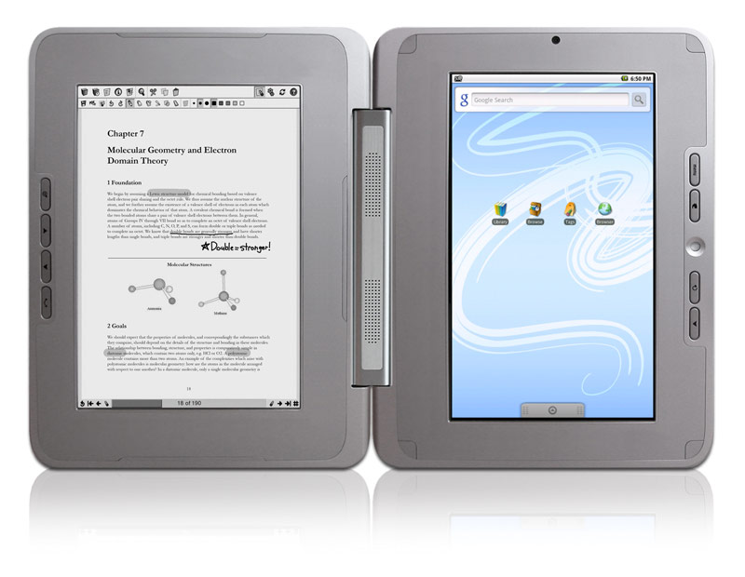
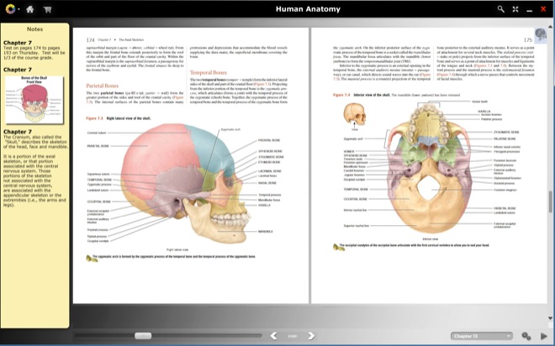
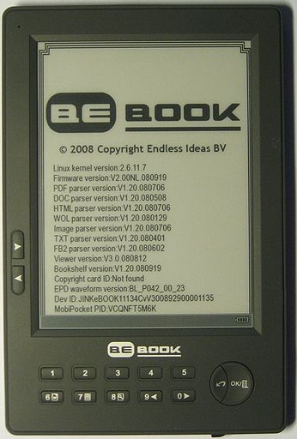

So many possibilities …
PDB
EPUB
MOBI
The book is probably the most successful technology ever.
-- Jeff Bezos
Newsweek, Dec 28, 2009
… AND IT’S ONLY BEGINNING!!!
AZW
HTML
But no technology, …, lasts forever.
-- Jeff Bezos
Newsweek, Dec 28, 2009
LIT
LRX
FB2
PRC
PDF
OPF

Slide 12
Formats, formats and more formats
Input formats
  MS Office
  OpenOffice
  InDesign
  Quark
  PDF
  Hardcopy
  XML
  HTML
  Others
eBook formats
  .LIT
  Mobi
  AZW
  PDB
  FB2
  PDF
  RTF
  BBeB
  EPUB
  HTML
  RB
  CHM
  OEB
DRM formats
  Microsoft Reader
  Adobe Adept
  eReader
  Mobi
  Apple FairPlay
  DNL
  and many others…

Slide 13
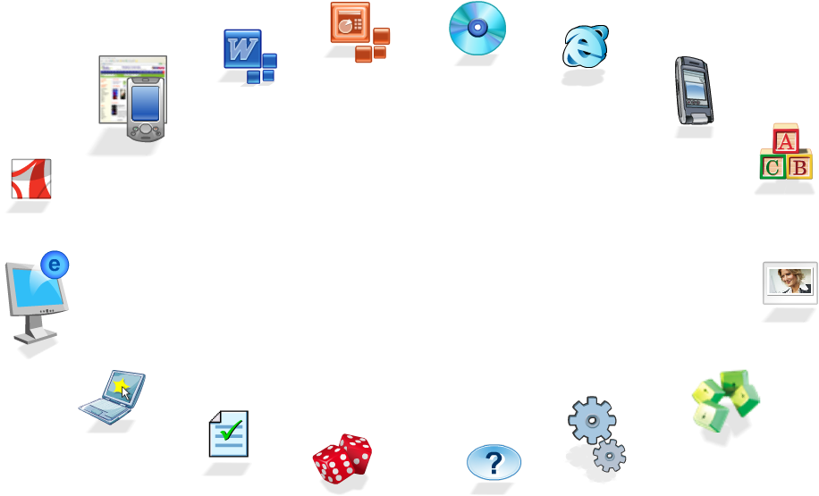


Delivery Options
Instructor
Resource
Companion CD
Student
Resource
Companion
Website
E- books
PDA-Based
Products
Learning
Aids
PDF's
Image
Banks
Elearning
Simulations
Interactivities
Case Studies
Animations
Games
Assessments
Notes:
This is a set of components for the previous slide.

Slide 14
Agenda
Introducing Aptara
Today’s Environment
Getting There From Here
Digital First & XML
14
Confidential. Not for distribution.

Slide 15

Getting there from here
Traditional print publishing practices do not translate well
Retrofitting is:
  Expensive
  Error prone
  Complicated
  Impractical
  NOT efficient
  NOT flexible
  NOT sustainable
Production processes must be re-engineered to
support new digital paradigms

Slide 16
eBook creation challenges
Multiple formats, hardware devices…which is best?
Cost of trying a new format and the risk of competition
Conversion costs due to a staggered production model
Processing challenges
  Accuracy of content
  Text formatting, fonts and alignment
  Figures / images / charts
  Tabular content
  Math
0
4
5
6
10
Manuscript Ready
“P” Book Released
E-Book Released
Companion Website Released
Elearning Course Launched
Notes:
We’re rapidly evolving from a sequential world and a sequential paradigm to a parallel one. Some actions that have always been done in lock-step order might be more efficiently done with overlap. It’s not easy to move from one thought process to another, and care must be taken not to lose quality or content.

Slide 17
eBook creation challenges
Consumer expectations
  interactive
    audio
    video
    animations
  available anywhere, anytime
  multi-device
  participative (“I matter and so does my opinion”)
  cost (micro-payments)
17
Notes:
People entering school or the workforce today didn’t experience a time before home computers. Their expectations are an unbounded upward spiral. More, faster, tinier, cheaper. And even they admit they are more self-centered, as exemplified by the modern social network scene and tweeting with the elite.

Slide 18


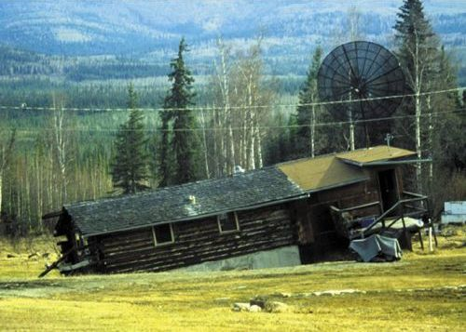
Without the right foundation …

Slide 19
Agenda
Introducing Aptara
Today’s Environment
Getting From Here to There
Digital First & XML
19
Confidential. Not for distribution.

Slide 20
Digital First
Content is king
  Layout and format support the end product
Device/platform agnostic data
  Based on open standards (XML, XSLT, CSS, etc.)
  Off-the-shelf processing tools
  Easily transformed to meet new delivery options
  Frees authors to create content
Competitive advantage
  Reduced costs
  Faster time to market
  Extends product’s shelf-life
  Allows for easier re-purposing of data
  New markets (e.g. vision impaired, literacy)
  Extensible for new media types

Slide 21
Workflows without XML
An accepted chapter (internally referred to as a “module”) is transmitted to ASM Press via e-mail by an EcoSal Executive Editor, Section Editor, or author (a raw Word document + illustration files [GIFs or JPEGs]). The Production Editor (PE) screens it and asks the author to supply any needed materials or information.
The CE applies the EcoSal Linking Utility macros (for automated hyperlinking of references, figures, tables, and cross-references to other modules and for automated application of PubMed search links to journal references).
The Author e-mails the Word file components back to the PE with any additional edits or answers to queries highlighted with “Track Changes.”
The PE checks the chapter on the beta site and notes any errors in content (typographical errors, for example) or display (usually resulting from faulty styling in the converted files, italic or boldfaced spaces, etc.).
The CE copyedits (in “Track Changes” mode) on Word document and cleans up the document’s component parts: core text, media list [table and figure captions], references, and tables.
The Production Editor (PE) sends the Word file(s) and illustrations to a copy editor (CE).
The PE accepts or rejects the author’s corrections in “Track Changes” mode in Word, reviews the Word file components again, and makes final checks of formatting/styling.
The PE retrieves from the archival ZIP folder the latest converted files, makes appropriate corrections, and sends the corrected files back to the Web site host’s FTP site with a slightly different name.
The CE removes any reference management software (such as Endnote) from the Word doc.
The CE returns the templated and copyedited Word file components to the PE.
The PE sends the approved Word file components and illustration files to the current Web site host via FTP.
The Web site host performs arcane magical processes again and then sends the PE a link to the revised chapter on the beta site.
The Web site host subjects the files to arcane magical processes not understood. Files are “converted” for Web display. The Web site host e-mails to the PE info on any needed tweaks that were made to file names or styles, notes resizing or cropping of illustrations done, etc., and also indicates the designation on the FTP site of the ZIP folder in which the final files are stored, for future/archival use (version control).
The CE imposes the template upon the Word doc.
The PE reviews the formatting/styling and copyediting changes and makes minor corrections.
The PE checks the module on the beta site again, approves it, and instructs the Web site host to post it. (At this point the PE may also prepare the modified “Domain” table of contents [TOC] for conversion and posting and forward it to the Web site host, for arcane magical processing and conversion and checking on the beta site. Eventually this TOC is approved and posted, too.)
The CE edits the references.
The PE e-mails the templated and copyedited Word file components to the Author to check the edits and answer any queries.
The current Web site host sends a link to the PE that leads to the beta site, where the converted chapter (“module”) resides.
The Web site posts the approved module to the EcoSal site. There is much rejoicing in all the land.
Notes:
he first edition of the American Society for Microbiology’s reference work, E.Coli & Salmonella, or EcoSal was a great success. Over 3500 pages in 2 volumes, it was the recognized work in the field. By the time it was ready for a second edition, enough important content had been gathered to create a 5 volume set. Moreover, the field was changing so rapidly, that it was feared that even this would be unsufficient.
The ASM decided to build a website for the work instead. It would provide PDF to replace the print and a web view as the primary look. Although highly advanced, the technology of the time (about 1999) did not have good web content management tools, so the site was traditionally designed. Old workflows for article/chapter development remained in place, and a cumbersome conversion process was used to finally update the web.
A complex and restrictive workflow that has too much dependence on various users within the content life cycle.
Multiple files are moved between various SMEs.
Tracking of content was a pain point. Lot of man hours spent by the publisher’s co-ordinator to move the content from one stage to next.
21

Slide 22

How XML can help
High-Quality Multi-Channel Output
Powerful, Laser-Focused Search
Dynamic, Flexible Personalization
Compatibility with RSS and Web 2.0 Technologies
Notes:
We’ve talked about the ecology of this marketspace – or at least the air (social) and the water (content/presentation). Now lets dig into the structure and see what’s needed to support this in a way that’s practical and economical. The old days of doing expensive one-offs are, we hope, history.

Slide 23
How XML has helped
B2B enterprises have benefited for years
Aerospace – improve the authoring and execution of flight procedures for the International Space Station
Airlines – manage and digitally deliver mission critical technical documentation and maintenance manuals that must be regularly revised
Pharmaceutical – process continuous volumes of time-sensitive drug research to expedite FDA approval
Automotive
Financial
High-tech – hardware and software
Publishing
23
Notes:
XML has become pretty much a 4th Generation technology. With roots in typesetting and programming, there are now sufficient tools and development to automate many tasks that formerly was very labor intensive. The key concepts about XML are that it is transferrable (XML-marked content plus a set of rules) from one system or vendor to another, and that it allows separation of content from design by allowing the content to be logically marked, and the design to be applied by a RENDERING ENGINE (RE). The RE may be a program like Quark QPS or InDesign CS4, or it may be a web server, or any other technology to send out formatted, designed content from XML.

Slide 24
How do I get to XML?
From legacy content and formats
  hardcopy
  application files
From print PDF files
As part of production processes
Using authoring applications
24
Notes:
XML has become pretty much a 4th Generation technology. With roots in typesetting and programming, there are now sufficient tools and development to automate many tasks that formerly was very labor intensive. The key concepts about XML are that it is transferrable (XML-marked content plus a set of rules) from one system or vendor to another, and that it allows separation of content from design by allowing the content to be logically marked, and the design to be applied by a RENDERING ENGINE (RE). The RE may be a program like Quark QPS or InDesign CS4, or it may be a web server, or any other technology to send out formatted, designed content from XML.

Slide 25
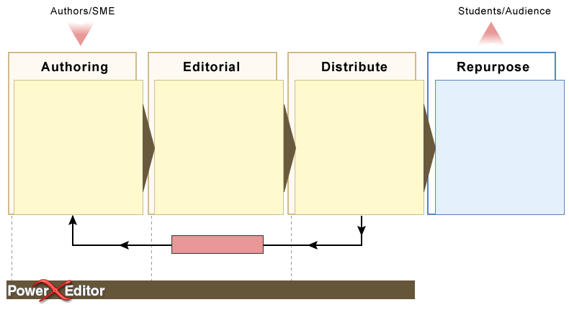

PowerXEditor – Digital-First Content Life Cycle
Friendly on-line environment
Project-specific templates
Advanced commenting
and query functions
Reference management
Work on PC, Macintosh
or UNIX/Linux platforms
Regular backups
Preview
Email notification & workflow
Maps business processes &
requirements
Flexible workflows
Phased production methodology
Custom Dictionaries
Report generation and
export to legacy systems
Check-in / check-out
process control
Status at-a-glance
User contact database
XML in / XML out
Seamless flow to
InDesign, FrameMaker+
XML, LaTeX, 3B2, and
formatters for XML
Quark Xpress and
other systems via add-ons or
plug-ins
Web-Ready with XSLT
and CSS
Print / Online / PDA / CD-Rom
eBook (multiple formats)
Multi-path XML export with
PERL or XSLT processing
Use PowerXEditor
Environment for data
storage and retrieval
Design output for
existing applications
Integrate with CMS and
publish to web
Content Revision
MANAGE: Content, Workflow, Roles & Users
25

Slide 26





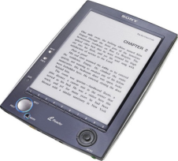



XML & Multi-channel Publishing
Produce the same content or information in more than one medium simultaneously
Use a single source for cross-media publishing
Integrate production of text and graphics for print with learning modules and animations for media
Edit the content once and publish it
multiple times
Advantages
  Reduced “Time to Market”
  Additional revenue channels
  Easier maintenance of data
  Consistency of data
  Overall cost saving
  Builds bridges between print and
  media world
Business Logic
XSLT - Processor

Slide 27
XML & EPUB
EPUB content standard
  allows publishers to produce and send a single digital publication file through distribution
  offers consumers interoperability between software/hardware for unencrypted reflowable digital books
  ".epub" is the file extension for EPUB reflowable digital books and publications
EPUB acronym soup
  container: OCF (Open [OEBPS] Container Format)
  markup packaging: OPF (Open Packaging Format)
  markup content: OPS (Open Publication Structure); XHTML & DTBook
Notes:
AAARGH! Avast ye mateys! Note that the standards only talk about unencrypted content. Where piracy is a concern, they also provide for plugging in encryption and copy-protection schemes at critical points. The dominant copy protection in the ePub world is Adobe’s Digital Editions technology. Most devices that support ePub directly also support Adobe Digital Editions.
The Kindle (and MobiPocket) formats may be derived from ePub via conversion. However the actual Digital Rights Management is applied by Amazon’s Kindle server or the Mobipocket server for Mobi Reader. The DRM is proprietary and specific to the Kindle and Mobipocket platforms.
Also worth noting is a trend toward SOCIAL DRM. In this case, nothing is restricted or encrypted, but confidential information about a purchaser – such as credit card info – is stamped into the content. So the user must take care not to redistribute.

Slide 28
In conclusion
Make ALL your content available digitally
Use an Digital-First XML foundation
  protects investment in content assets
  extends the life of new and existing content assets
  provides a solid base on which to add new features and media
Automation of digital workflows is critical
Quality assurance on actual devices is essential

Slide 29

Questions?
Visit us on the exhibit floor

